Slide 1

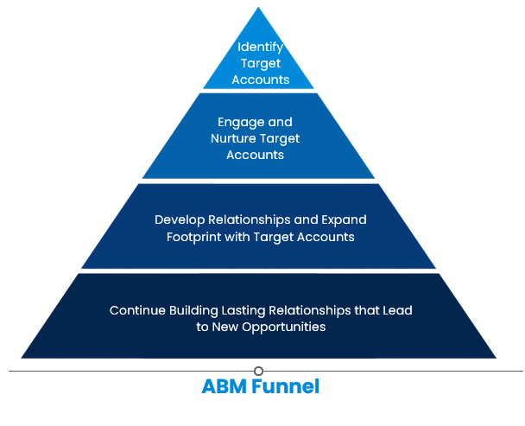

– HubSpot & ABM Support
Overview
Exos provides corporate wellness and fitness center management to corporations. They leverage HubSpot for marketing automation and were looking to incorporate Account Based Marketing (ABM) strategies to increase brand awareness and generate additional leads.
Exos was unsure what specific ABM approach to employ, how to leverage HubSpot’s tools, what next steps they should take etc.
Affirma Support
Performed comprehensive HubSpot assessment and provided findings and recommendations
Provided advisement on target account selection, list segmentation, content mapping, HubSpot’s specific ABM features, KPIs to track success as well as an order of operations to implement
Benefits of ABM for Exos:
Holistic view of marketing beyond lead generation
Sales and marketing teams work in collaboration
Pipeline Acceleration with reduced sales cycles
Efficiencies with time and budget
Increased customer experience
Lite Approach
1 to Few

